Slide 1
Lesson 8
Introduction to Laravel
PHP Framework

Slide 2
Session One Learning Objectives
At the end of this Session/Topic, the Learner should be able to:
Define the term web application
Define a web application framework such as Laravel
Install Laravel Version 8 in a windows WAMP server
Configure the Laravel .env File
Create Basic Routes, Controllers and Views
Create a GitHub account
Push your Code to Git-Hub

Slide 3
Introduction
Laravel is a free, open source PHP web application framework, designed for the development of model-view-controller (MVC) web applications.
Laravel allows you to develop applications which are flexible, user-friendly and clean.
The pe-requiste for this course is the knowledge of PHP, JavaScript, OO PHP and MYSQL database design

Slide 4
Introduction(cont.)
In this Course, we will begin by preparing a environment and learning how to download and install Laravel, how to use Composer to install Laravel, how to use Artisan (the Laravel command line tool), how to work with Routes, Views, Blade templates, Controllers and Models.

Slide 5
Laravel Installation Steps
Install Wamp Server(use Bitnami Wamp)
Install Composer
Install Laravel
Configure Laravel

Slide 6






Dev Tools Required
WAMP packaged
by Bitnami

Slide 7
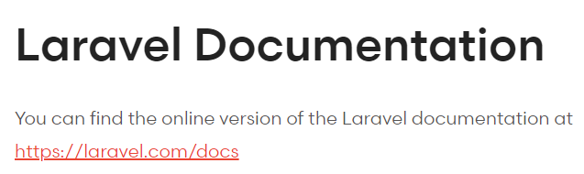


Supportive Websites

Slide 8
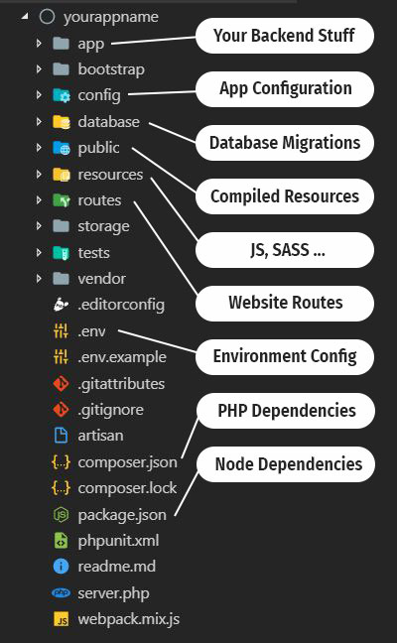
Directory Structure Of Laravel Application

Slide 9
Laravel: Main Application
Folders
Each of these folders fulfills a specific task for the overall functioning of the framework.
The purpose of each of these folders is explained below:

Slide 10
The App Directory
Directory | Purpose
Console | This directory contains all Artisan commands which are created by us. These commands can be generated using the php artisan make: command command.
Exceptions | This directory contains the application’s exception handling files. Here you can create your own specific exceptions to be thrown by our application.

Slide 11
The App Directory(cont.)
Http | This directory contains our controllers, middleware, and form requests. Almost all of the backend to handle requests entering our application will be placed here.
Providers | This directory contains all of the service providers for the application. Service providers bootstrap our application by making services available to us by registering them.
Broadcasting | This directory is not there by default but can be created by using the php artisan make:channel command. It contains all of the broadcast channel classes for our application to broadcast your events.

Slide 12
The App Directory(cont.)
Events | This directory is not there by default but can be created by using the php artisan make:event command. This directory contains event classes which can be used to give signals to other parts of the application or vice-versa.
Jobs | This directory is not there by default but can be created by using the php artisan make:job command. This directory contains lineup jobs for our application.
Listeners | This directory is not there by default but can be created by using the php artisan make:listener command. This directory contains the classes that handle our events.

Slide 13
The App Directory(cont.)
Mail | This directory is not there by default but can be created by using the php artisan make:mail command. This directory contains all of our classes that represent emails sent by application.
Notifications | This directory is not there by default but can be created by using the php artisan make:notification command. This directory contains all of the “transactional” notifications that are sent by our application.
Policies | This directory is not there by default but can be created by using the php artisan make:policy command. This directory contains the authorization policy classes which are used to determine if a user can access or change a specific data or not.
Rules | This directory is not there by default but can be created by using the php artisan make:rule command. This directory contains the self-created validation rule objects which are used to encapsulate complicated validation logic in a simple object.

Slide 14
The Bootstrap Directory
This directory contains app.php from where the whole framework bootstraps.
This directory also contains the cache directory which is used to store framework generated files for performance optimization.

Slide 15
The config directory
This directory contains all the configuration files related to database, mail, session, services, etc.

Slide 16
The database Directory
This directory contains database migrations, model factories, and seeds.

Slide 17
The public Directory
This directory contains the index.php file which is the entry point and handles all requests received by the application and configures autoloading too.
Apart from this, this directory also contains assets used in the application like images, javaScript, and CSS.

Slide 18
The resources Directory
This directory contains the frontend of the application.
All the HTML code which makes the frontend of application is present here in the form of Blade templates which is a templating engine Laravel comes with.

Slide 19
The routes directory:
This directory contains all the route definitions of the application.

Slide 20
The storage Directory:
This directory contains the compiled Blade templates, file based sessions, file caches, and other files generated by framework.

Slide 21
The tests Directory:
This directory contains all of our automated tests which are required to ensure that the application is working as per expectations or not.

Slide 22
The vendor Directory:
This directory contains all the dependencies downloaded through Composer needed by our framework.

Slide 23
Middleware
Middleware provide a convenient mechanism for filtering or examining HTTP requests entering your application.
For example, Laravel includes a middleware that verifies if the user of your application is authenticated.
If the user is not authenticated, the middleware will redirect the user to the login screen.
However, if the user is authenticated, the middleware will allow the request to proceed further into the application.

Slide 24
Request Lifecycle
The entry point for all requests to a Laravel application is the public/index.php file.
All requests are directed to this file by your web server (Apache / Nginx) configuration.
The index.php file doesn't contain much code.
Rather, it is a starting point for loading the rest of the framework.

Slide 25
Request Lifecycle(cont.)
The index.php file loads the Composer generated autoloader definition, and then retrieves an instance of the Laravel application from bootstrap/app.php.
The first action taken by Laravel itself is to create an instance of the application / service container.

Slide 26
The end Thank you

